Slide 1

Unit Testing and Modules
Error and Exception Handling, Modules, Unit Testing, Assertions
SoftUni Team
Technical Trainers
Software University
https://softuni.bg

Slide 2
Table of Contents
Modules
Unit Testing - Concepts
Mocha and Chai for Unit Testing

Slide 3
Have a Question?
sli.do #js-advanced

Slide 4

Modules
Definition, Import, Export

Slide 5
Modules
A set of functions to be included in applications
Group related behavior
Resolve naming collisions
http.get(url) and students.get()
Expose only public behavior
They do not populate the global scope with unnecessary objects
const loading = {
show() { }, hide() { },
};
a module for loading indicator

Slide 6
Approaches for Modules
Since, modules were not native in JS, there are different approaches to create modules:
Using IIFE
Using Nodejs require/export
Using ES2015 import/export

Slide 7
IIFE Modules
IIFE modules are essential for front-end JS
They hide the unnecessary and expose only needed behavior/objects to the global scope
(function(scope) {
const selector = 'loading'; const loadingElement = document.querySelector(selector) const show = () => loadingElement.style.display = ''; const hide = () => ladingElement.style.display = 'none' // Only this is visible to the global scope scope.loading = { show, hide };
}(window));

Slide 8
Node.js Modules
require() is used to import modules
Internal modules need to be exported before being required
In Node.js each file has its own scope
const http = require('http');
// For NPM packages
const myModule = require('./myModule.js');
// For internal modules

Slide 9
Node.js Modules
Whatever value has module.exports will be the value when using require
To export more than one function, the value of module.exports will be an object
const myModule = () => {...};
module.exports = myModule;
module.exports = { toCamelCase: convertToCamelCase, toLowerCase: convertToLowerCase };

Slide 10
ES6 Modules
Always import and export an object
Only a specific function can be imported
To import the whole object
To change the name after importing
import toLowerCase from './toLowerCase.js';
import * as myModules from './myModules.js';
import { toLowerCase as convertToLowerCase } from './myModules.js';

Slide 11

Unit Testing
Definition, Structure, Examples, Frameworks

Slide 12
Unit Testing
A unit test is a piece of code that checks whether certain functionality works as expected
Allows developers to see where & why errors occur
function sortNums(arr) { arr.sort((a,b) => a - b); }
let nums = [2, 15, -2, 4]; sortNums(nums);
if (JSON.stringify(nums) === "[-2,2,4,15]") { console.error("They are equal!");
}

Slide 13
Unit Testing
Testing enables the following:
Easier maintenance of the code base
Bugs are found ASAP
Safer development
The so called "Test-driven development"
Tests before code
Automated way to find code wrongness
If most of the features have tests, running them shows their correctness

Slide 14
Unit Tests Structure
The AAA Pattern: Arrange, Act, Assert
// Arrange all necessary preconditions and inputs
let nums = [2, 15, -2, 4];
// Act on the object or method under test
sortNums(nums);
// Assert that the obtained results are what we expect
if (JSON.stringify(nums) === "[-2,2,4,15]") {
console.error("They are equal!");
}

Slide 15

Unit Testing Frameworks
JS Unit Testing:
Mocha, QUnit, Unit.js, Jasmine
Assertion frameworks (perform checks):
Chai, Assert.js, Should.js
Mocking frameworks (mocks and stubs):
Sinon, JMock, Mockito, Moq

Slide 16

Unit Testing with Mocha and Chai

Slide 17
What is Mocha?
Feature-rich JS test framework
Provides common testing functions including it, describe and the main function that runs tests
Usually used together with Chai
describe("title", function () {
it("title", function () { … });
});

Slide 18
What is Chai?
A library with many assertions
Allows the usage of a lot of different assertions such as assert.equal
let assert = require("chai").assert;
describe("pow", function() {
it("2 raised to power 3 is 8", function() {
assert.equal(pow(2, 3), 8);
});
});

Slide 19

Global Installation

Slide 20

Global Installation
To install frameworks and libraries globally, use the CMD
Installing Mocha and Chai through npm
Check if Mocha is installed
npm install –g mocha
npm install –g chai
mocha --version

Slide 21
NODE_PATH Configuration
By default Node.js does not find its globally installed modules
You need to set the NODE_PATH environment variable
You may need to restart your IDE after changing NODE_PATH
rem for any future sessions
setx NODE_PATH %AppData%\npm\node_modules
rem for current session
set NODE_PATH=%AppData%\npm\node_modules

Slide 22
Usage and Examples
To load a library, we need to require it
const expect = require("chai").expect;
describe("Test group #1", function () {
it("should… when…", function () {
expect(actual).to.be.equal(expected);
});
it("should… when…", function () { … });
});
describe("Test group #2", function () {
it("should… when…", function () {
expect(actual).to.be.equal(expected);
});
});

Slide 23
Problem: 1. Sum of Numbers
Write tests to check the functionality of the following code:
function sum(arr) {
let sum = 0;
for (num of arr)
sum += Number(num);
return sum;
}

Slide 24
Solutions: 1. Sum of Numbers
describe('sum', function() {
it('test with string, returns NaN', function () {
let actual = sum('abc');
expect(actual).to.be.NaN;
});
it('test with array of str, returns number', function() {
let expected = sum(['1','2']);
expect(expected).to.equal(3, 'papameter in not array of numbers');
});
it('expect sum ([1,2.3] to be 6)', function() {
let expected = 6;
let actual = sum([1,2,3]);
expect(actual).to.equal(expected);
})
});

Slide 25

Learn the "Test First" Approach to Coding

Slide 26
Unit Testing Approaches
"Code First" (code and test) approach
Classical approach
"Test First" approach
Test-driven development (TDD)

Slide 27
The Code and Test Approach
Write code
Write unit test
Run and succeed
Time flow

Slide 28
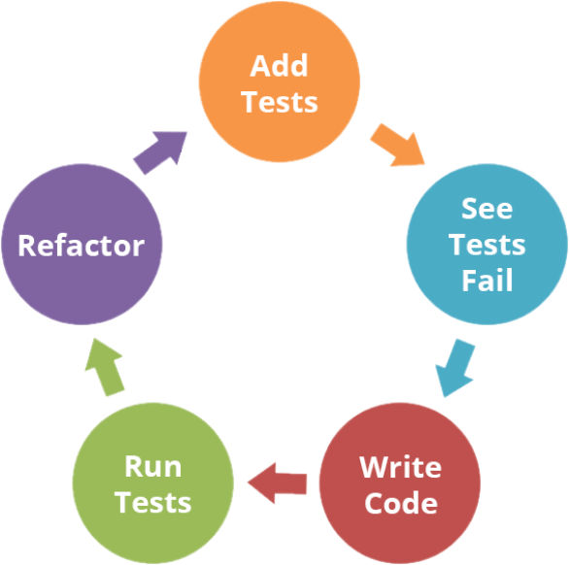
The Test-Driven Development Approach

Slide 29
Test-Driven Development (TDD)
Create a test list
Pick а test
Write test
Compile and fail
Write enough code to compile
Run test and fail
Write code to pass test
Time flow
Remove duplication

Slide 30

Why TDD?
TDD helps find design issues early
Avoids reworking
Writing code to satisfy a test is a focused activity
Less chance of error
Tests will be more comprehensive than if they are written after the code

Slide 31

Unit Testing

Slide 32

Summary
…
…
…
Modules are a set of functions to be included in applications
Unit tests check if certain functionality works as expected
Test-driven development (TDD)

Slide 33
Questions?
Notes:
33

Slide 34












SoftUni Diamond Partners

Slide 35




SoftUni Organizational Partners

Slide 36
Trainings @ Software University (SoftUni)
Software University – High-Quality Education, Profession and Job for Software Developers
softuni.bg, about.softuni.bg
Software University Foundation
softuni.foundation
Software University @ Facebook
facebook.com/SoftwareUniversity
Software University Forums
forum.softuni.bg
Notes:
36

Slide 37

License
This course (slides, examples, demos, exercises, homework, documents, videos and other assets) is copyrighted content
Unauthorized copy, reproduction or use is illegal
© SoftUni – https://about.softuni.bg/
© Software University – https://softuni.bg
Notes:
37

